Slide 1
Handling missing data using Python and R
Daniel Low, Bogdan Petre and Andrea Xu
Team 07
Introduction to Data Science
University of Groningen
2017

Slide 2

Overview of the tutorial
Dataset: titanic aftermath
Types of missingness
Solution 1: single imputation
Solution 2: multiple imputation
Conclusions
On April 15, 1912, the Titanic sank after colliding with an iceberg, killing 1502 out of 2224 passengers and crew.

Slide 3
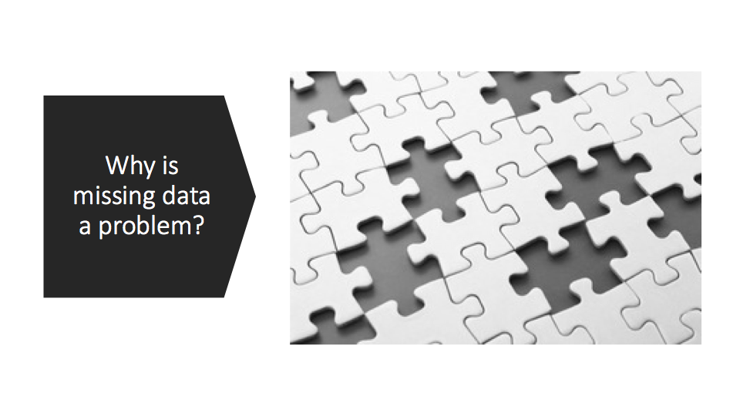

Slide 4
Types of Missing Data
Missingness completely at random
  Ideal
  Example: some documents got damaged at random with no pattern.
Missigness almost at random:
  NaNs depends somewhat on other variables
  Example: 3rd class passengers do not have as many records as 1st class passengers.
Missigness that depends on unobserved predictors
  Perhaps minorities were registered less than the British passengers
  Unobserved predictor: ethnicity
Missigness that depends on the missing value itself
  3rd class passengers may not reveal that they were 3rd class.

Slide 5
Let’s go to Jupyter Notebook tutorial!

Slide 6
Conclusions
Make sure you understand how missing data and your solution to it limits your analysis.
Try out multiple imputation:
  It accounts for the uncertainty in the imputations
  It uses the other variables to compute imputations
Github with tutorials: https://github.com/bogdanp05/IDS_Assignment2

Slide 7

Thank you!

